Slide 1
Single cycle MIPS CPU (24 instructions ，Hardwired Controller)

Slide 2
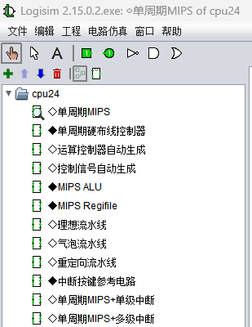
设计内容
Circuit design：
Sports watch
Single cycle MIPS CPU (8+3 instructions)
Multi cycle MIPS CPU (Microprogram Controller, 8 instructions)
Multi cycle MIPS CPU (Hardwired Controller, 8 instructions)
Single cycle MIPS CPU (24 instructions)
MOOC“Computer Hardware System Design”
（1）6.1 Single cycle MIPS architecture
（2）6.2 Multi cycle MIPS architecture
（3）6.3 Single cycle MIPS CPU design (8 instructions)
（4）6.4 Multi cycle MIPS CPU (Microprogram Controller) Design
（6）6.6 Single cycle MIPS CPU design (24 instructions)
https://www.icourse163.org/course/HUST-1205809816
cpu24.circ

Slide 3
Single cycle 24 instruction hard wired MIPS CPU design task:
Master the basic principles of designing a single cycle hardwired MIPS CPU (24 instructions);
Design a single cycle hardwired MIPS CPU with 24 instructions (including a single cycle MIPS path diagram, hardwired controller)， Verificate on TOUGE platform；
Test and run benchmark.hex on the CPU；
Option: each person will perform different CCMB instructions and test them using the test program provided in "汇编工具及测试用例4.32.zip"。
Option:Ideal pipeline CPU
Option:Bubble pipeline CPU

Slide 4
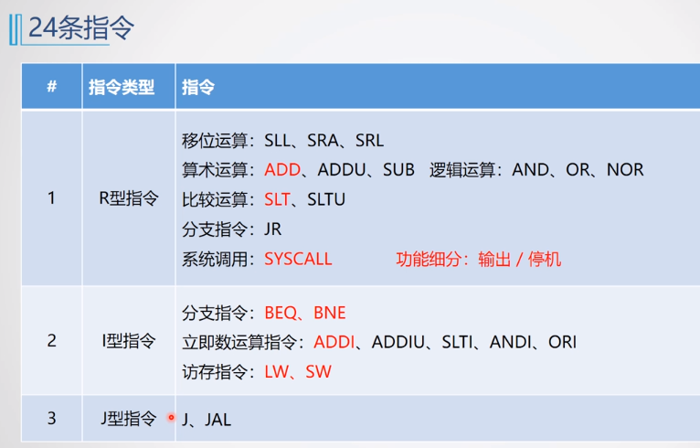
序号 | 指令 | OpCode (十进制) | FUNCT (十进制)
1 | SLL | 0 | 0
2 | SRA | 0 | 3
3 | SRL | 0 | 2
4 | ADD | 0 | 32
5 | ADDU | 0 | 33
6 | SUB | 0 | 34
7 | AND | 0 | 36
8 | OR | 0 | 37
9 | NOR | 0 | 39
10 | SLT | 0 | 42
11 | SLTU | 0 | 43
12 | JR | 0 | 8
13 | SYSCALL | 0 | 12
14 | J | 2 | X
15 | JAL | 3 | X
16 | BEQ | 4 | X
17 | BNE | 5 | X
18 | ADDI | 8 | X
19 | ANDI | 12 | X
20 | ADDIU | 9 | X
21 | SLTI | 10 | X
22 | ORI | 13 | X
23 | LW | 35 | X
24 | SW | 43 | X

Slide 5
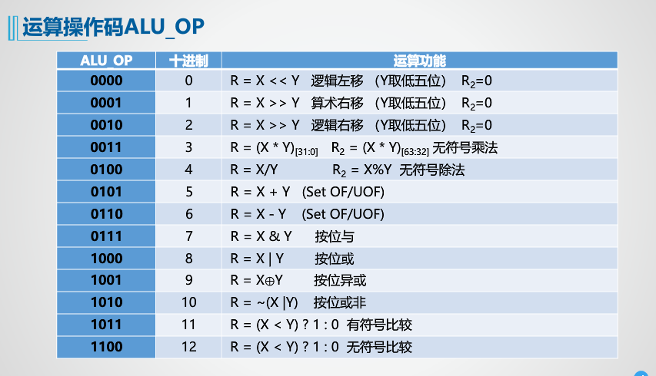
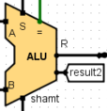
ALU_OP control signal
X<<shamt
X>>shamt
X>>shamt
R运算:
R型指令运算扩充只要修改ALUOP字段即可，但是在CCMB中的乘除法运算需要设置hi、lo寄存器
I运算:
I型指令逻辑运算扩充需要增加0扩展部件，控制器也需要增加SignedExt
控制信号，指示imm16的扩展方式
SLL
SRA
SRL
ADD
ADDU
SUB
AND
OR
NOR
SLT
SLTU
ADDI
ANDI
ADDIU
SLTI
ORI

Slide 6
Summary of other control signals
# | 控制信号 | 信号说明 | 产生条件（信号为1）
1 | RegWrite | Register write enable | WB
2 | MemWrite | memory write enable | sw
3 | AluOP | ALU function（4bit） | Rtype,Itype Arithmetic and shift instruction
4 | MemToReg | Register write data from memory | lw
5 | RegDst | Write register w# from rt or rd | R型指令
6 | AluSrcB | ALU B input selection | lw，sw，Itype Arithmetic instruction
7 | SignedExt | sign extension 16-32 | ADDI、ADDIU、SLTI
8 | JR | RS→PC | JR
9 | JAL | PC+4→$31 | JAL
10 | JMP | J | J、JAL
11 | Beq | Beq | Beq
12 | Bne | Bne | Bne
13 | Syscall | Syscall | stop or output based on the value of the $2 register

Slide 7
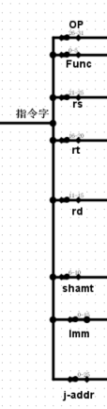
order | NAME | OpCode | FUNCT | FUNCTION | Partial control signal | TYPE
 |  | (十进制) | (十进制)
1 | SLL | 0 | 0 | R[rd] = R[rt] << shamt | ALU_OP=0000,RegWrite,RegDst | R
2 | SRA | 0 | 3 | R[rd] = R[rt] >> shamt | ALU_OP=0001,RegWrite,RegDst | R
3 | SRL | 0 | 2 | R[rd] = R[rt] >> shamt | ALU_OP=0010,RegWrite,RegDst | R
4 | ADD | 0 | 32 | R[rd] = R[rs] + R[rt] | ALU_OP=0101,RegWrite,RegDst | R
5 | ADDU | 0 | 33 | R[rd] = R[rs] + R[rt] | ALU_OP=0101,RegWrite,RegDst | R
6 | SUB | 0 | 34 | R[rd] = R[rs] - R[rt] | ALU_OP=0110,RegWrite,RegDst | R
7 | AND | 0 | 36 | R[rd] = R[rs] & R[rt] | ALU_OP=0111,RegWrite,RegDst | R
8 | OR | 0 | 37 | R[rd] = R[rs] | R[rt] | ALU_OP=1000,RegWrite,RegDst | R
9 | NOR | 0 | 39 | R[rd] = ~ (R[rs] | R[rt]) | ALU_OP=1010,RegWrite,RegDst | R
10 | SLT | 0 | 42 | R[rd] = (R[rs] < R[rt]) ? 1 : 0 | ALU_OP=1011,RegWrite,RegDst | R
11 | SLTU | 0 | 43 | R[rd] = (R[rs] < R[rt]) ? 1 : 0 | ALU_OP=1100,RegWrite,RegDst | R
12 | JR | 0 | 8 | PC=R[rs] | JR | R
13 | SYSCALL | 0 | 12 | if $v0==34 then display $a0 else pause，waiting GO to continue;$2,$4 | SYSCALL | R
14 | J | 2 | X | PC = PC31..28 || instr_index || 00 （JUMP ADDR） | JMP | J
15 | JAL | 3 | X | $31=PC+4,PC=PC31..28 || instr_index || 00 | JAL，JMP,RegWrite | J
16 | BEQ | 4 | X | if(R[rs]==R[rt]) PC=PC+4+imm16<<2 | BEQ, SignedExt | I
17 | BNE | 5 | X | if(R[rs]!=R[rt]) PC=PC+4+imm16<<2 | BNE, SignedExt | I
18 | ADDI | 8 | X | R[rt] = R[rs] + SignExtImm | ALU_OP=5,SignedExt,RegWrite,ALU_SRC | I
19 | ANDI | 12 | X | R[rt] = R[rs] & ZeroExtImm | ALU_OP,RegWrite,ALU_SRC | I
20 | ADDIU | 9 | X | R[rt] = R[rs] + SignExtImm | ALU_OP,SignedExt,RegWrite,ALU_SRC | I
21 | SLTI | 10 | X | R[rt] = (R[rs] < SignExtImm)? 1 : 0 | ALU_OP,SignedExt,RegWrite,ALU_SRC | I
22 | ORI | 13 | X | R[rt] = R[rs] | ZeroExtImm | ALU_OP,RegWrite,ALU_SRC | I
23 | LW | 35 | X | R[rt] = M[R[rs]+SignExtImm] | ALU_OP,SignedExt，ALU_SRC,RegWrite,MemtoReg | I
24 | SW | 43 | X | M[R[rs]+SignExtImm] = R[rt] | ALU_OP,SignedExt,ALU_SRC,MemWrite | I

Slide 8
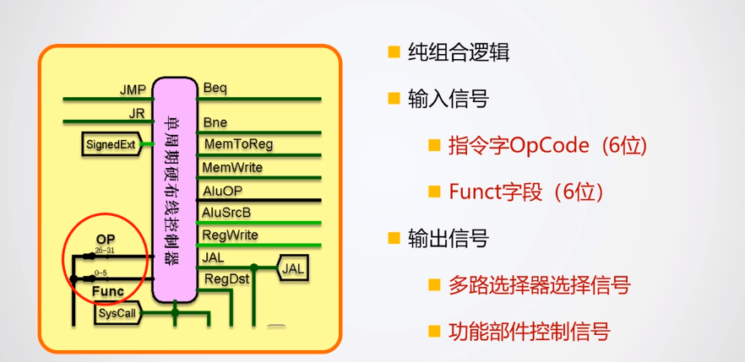
Using Universal Tables

Slide 9
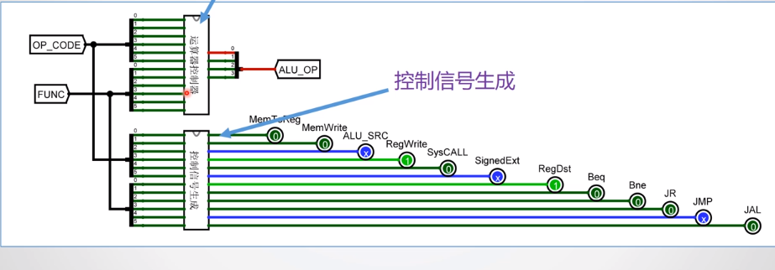
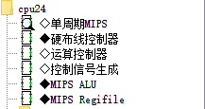
The hardwired controller consists of two sub circuits: an ALU controller and other control signal generation circuits
cpu24.circ Hardwired controller circuit

Slide 10
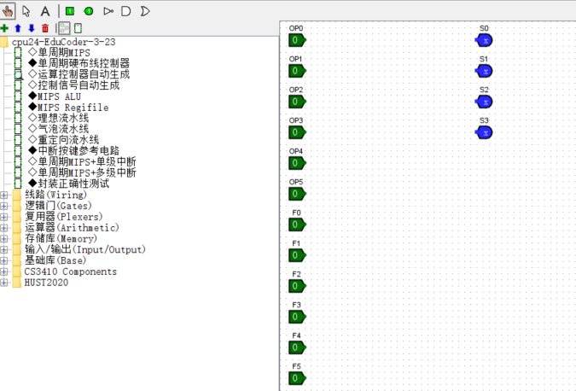
Using Universal Tables

Slide 11
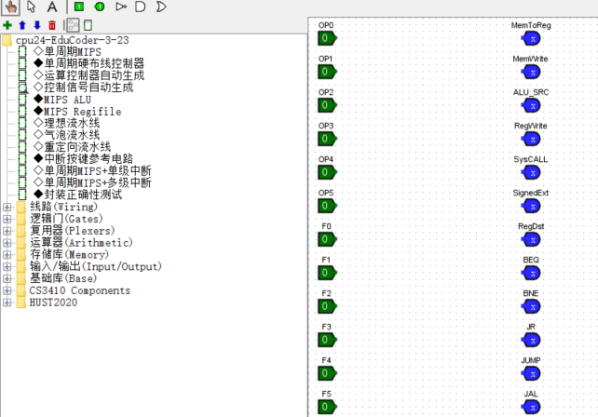
Using Universal Tables

Slide 12
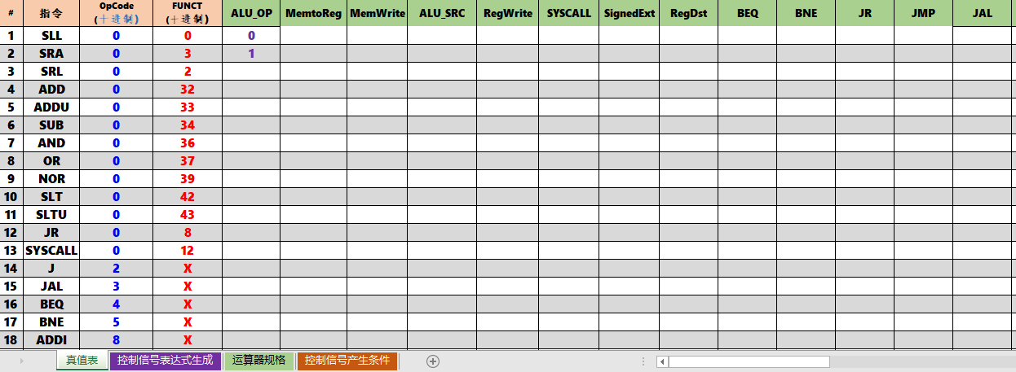
Rookie Table

Slide 13
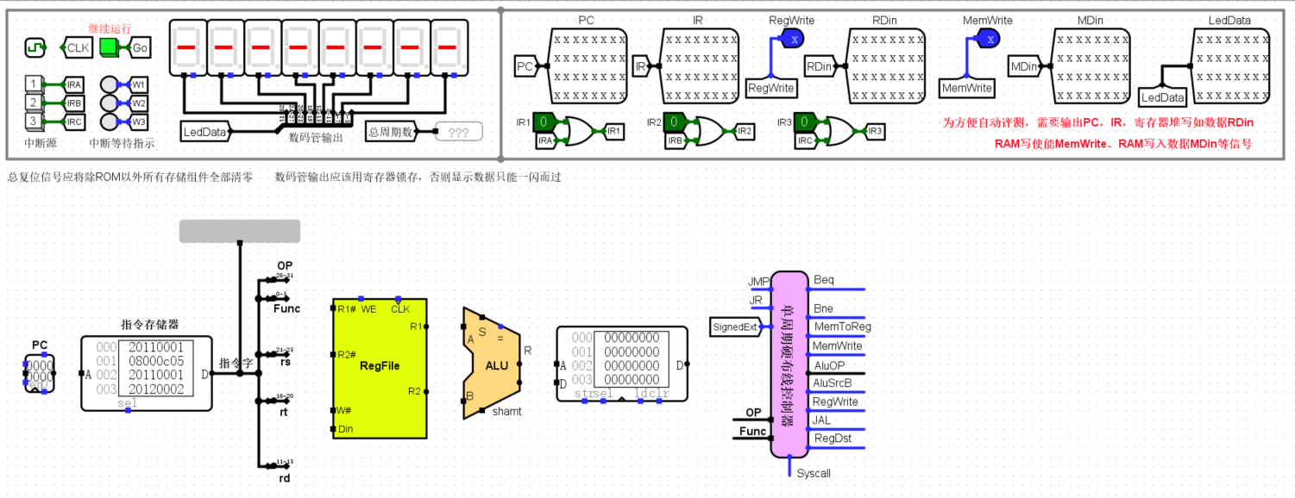
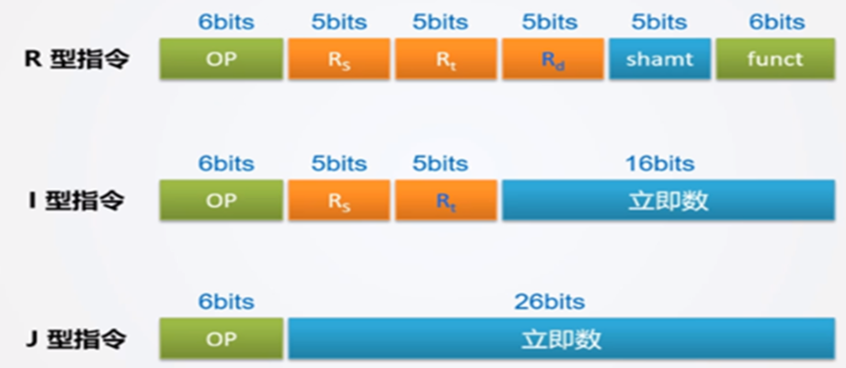

Slide 14
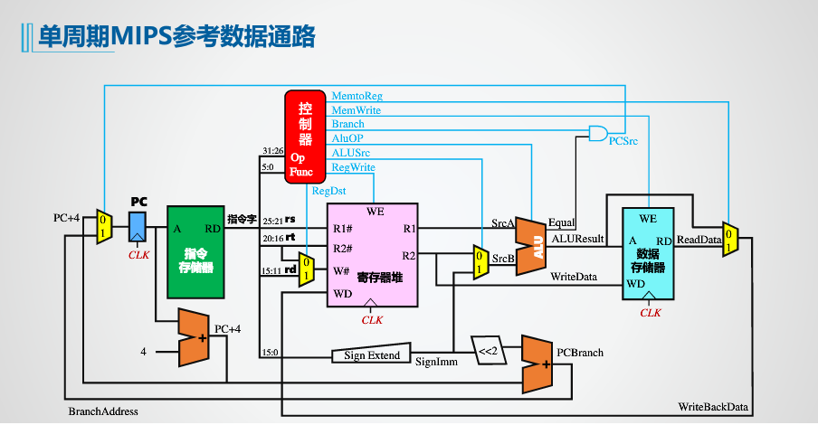
1、shamt的提取连接，运算类R指令
2、JR实现：PC=R[RS]
3、J实现：PC = PC31..28 || instr_index || 00
4、JAL：$31=PC+4,PC=PC31..28 || instr_index || 00
5、BEQ:if(R[rs]==R[rt]) PC=PC+4+IMM16<<
6、ADDI:R[rt] = R[rs] + SignExtImm
7、ANDI:R[rt] = R[rs] & ZeroExtImm
8、LW:R[rt] = M[R[rs]+SignExtImm]
9、SW:M[R[rs]+SignExtImm] = R[rt]
10、SYSCALL：if $2==34 then 显示$4 else 暂停，等GO按钮继续
Extended Eight Instruction Path Graph
SYSCAL

Slide 15
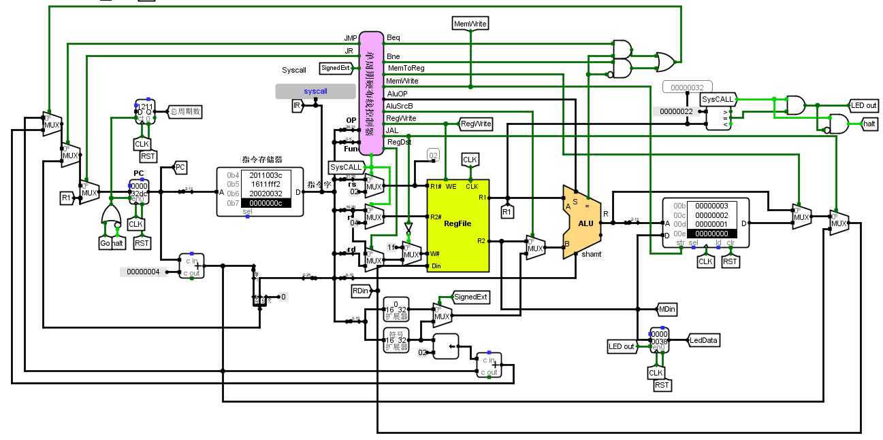
1、shamt的提取连接，运算类R指令
2、JR实现：PC=R[RS]
3、J实现：PC = PC31..28 || instr_index || 00
4、JAL：$31=PC+4,PC=PC31..28 || instr_index || 00
5、BEQ:if(R[rs]==R[rt]) PC=PC+4+IMM16<<
6、 ADDI:R[rt] = R[rs] + SignExtImm
7、ANDI:R[rt] = R[rs] & ZeroExtImm
8、LW:R[rt] = M[R[rs]+SignExtImm]
9、SW:M[R[rs]+SignExtImm] = R[rt]
10、SYSCALL：if $2==34 then 显示$4
else 暂停，等GO按钮继续

Slide 16
PC next address selection (can use 2-1 MUX)
PC+4
PCBranch
JMPADDR
MUX
PC
RS
BEQ,BNE,=
JR
CLK
RST
PCEN
J,JAL
JMPADDR= PC31..28 || instr_index || 00 PC=PC+4
PCBranch=PC+4+IMM16<<2

Slide 17
Critical circuit:JAL
JAL（JUMP AND LINK）：JAL imm26/ JAL instr_index
JAL:$31=$ra=PC+4, PC=JMPADDR= PC31..28 || instr_index26 || 00
W#=31，Din=PC+4，Regwrite
Questions:
Why is the instruction manual $ra=PC+8?
What is the subroutine return instruction?
How to handle multiple calls?
1、Because MIPS adopts delay-slot technology. At this time, the next instruction after JAL has already entered the pipeline, so the next instruction must be executed. Therefore, the returned address is: PC+8; In Experiment 4, it was not a pipeline CPU, and the return address was PC+4
2、MIPS does not have a RET instruction similar to X86, replaced by JR $ra
3、Multiple calls, the system performs stack pushing and poping on $ra.

Slide 18
Critical circuit:syscall
SYSCALL：if $2==34 then display $4 else pause，waiting GO to continue;$2,$4
When the control signal SYSCALL=1, set R1 #=2 and R2 #=4 for REGFILE (use 2 MUX added in front of R1# and R2#);
Compare the R1 value with the constant 34, and send the R2 value to LedData when it is equal, otherwise send HALT;
HALT and GO control PC Enable together;

Slide 19
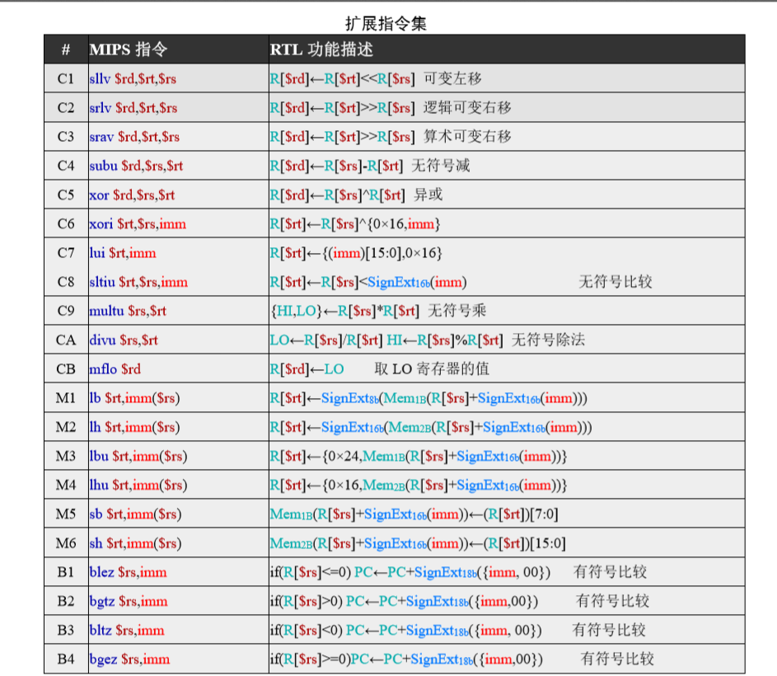
Differentiated task: 21 extended instruction sets
Option: Each student extends an additional 4 instructions, including 2 C-class instructions, 1 M-class instruction, and 1 B-class instruction, abbreviated as CCMB series instructions. The specific instructions for each student can be found in the task allocation table. The experimental package file "汇编工具及测试用例4.32.zip" already includes testing programs for all CCMB series instructions.
For example, someone‘s CCMB value is 3A43, and the extension instructions assigned to the student are C3/CA/M4/B3；
自编验证程序

Slide 20

单选题
1分
在CCMB系列指令中，每位学生需要扩展多少条指令？
A
2条
B
3条
C
4条
D
5条
提交

Slide 21
单选题
1分
在CCMB的C1-C3移位指令中，要将（）接到ALU的shamt引脚
A
RS的低5位
B
RT的低5位
C
RD的低5位
指令的6-10位
D
提交

